Slide 1
Automatic Traceability Links Recovery (TLR)
Thazin Aung
http://www.webtrace.tech/Home/VisualizeTraceLinks
Notes:
My thesis is about Visualization Techniques for presenting Requirements Traceability (RT) data from agile projects

Slide 2
Agenda
What is Software Traceability?
Why Traceability important in software development?
Paper Review
Problem Address
Architecture
Notes:
These are the agenda I will cover on the presentation today.
My main focus on thesis is Requirements Traceability Visualization. Thus, I will give you the brief background of what is requirements traceability. Why are the benefits of RT .
What are the artifacts available to trace.
Then, I will move my focus on visualization aspects of Requirements Traceability and its existing challenges.
Then, I will explain my aims and objectives and stakeholders for my thesis

Slide 3
What is Requirements Traceability
“the ability to describe and follow the life of requirement, in both a forwards and backward direction (i.e through its development and specification, to its subsequent development and use, and through all periods of on-going refinement and iteration in any of these phrases)”
(Gotel & Finkelstein 1994, p.94)
Idea
Trace Artifacts
Requirements
Functional Requirements
Non-Functional Requirements
Design
Source Code
Test Case
Implementation

Slide 4
Why Traceability important in software development?
Support Change Impact Analysis
By using RT trace data, Project team can able to identify which part of the system will be affected by a particular requirements changes
Support System Verification and Validation
By using RT Information, the overall system verification and validation can be done systematically
Notes:
To recap, why requirements management activities need to have requirements traceability process
First it support coverage analysis, By using RT trace data, the stakeholders can able to check no requirements are overlooked
Second it support test coverage, By using RT information, testing team can able to cross check and verify whether all the requirements have corresponding test cases and vice versa
Third it support change impact analysis, By using RT trace links, project team can able identified which system artifacts will be affected by a particular requirements changes
Fourth it support scope management, By using RT information, the project can team able to manage the project status. Eg, traceability allow to see the completion status of requirements
Last one is system verification and validation, By using RT information, the overall system verification and validation can be done systematically
So these are the five main areas, traceability results can be applied
Next slide, I will move my focus to trace artifacts

Slide 5
Paper Review
Semantically enhanced software traceability using
Deep Learning Techniques
Authors | Jin Guo ; Jinghui Cheng ; Jane Cleland-Huang
Year | 2017
Conference | International Conference on Software Engineering (ICSE)

Slide 6
Problem Address
Apply the Skip-gram Word Embedding & Recurrent Neural Network (RNN) Model to incorporate requirements semantics and domain knowledge in recovering traceability links between requirements and design artifacts. Below is the case scenario
Req
Req Doc | The BOS Administrative Toolset shall allow the Authorized Administrator to view an On-board’s last reported On-board Software Version, including the associated repository name, MD5, and whether the fileset is preferred or acceptable.
Design Doc | The Operational Data Panel is used to provide information about the current PTC operations in a subdivision
Why it is related? | BOS Administrative Toolset contains the Operational Data Panel, each locomotive contains an On-board unit for PTC operation, and that the Operational Data Panel displays the information of locomotives such as the On-board Software Version to the BOS Authorized Administrator.
Design

Slide 7
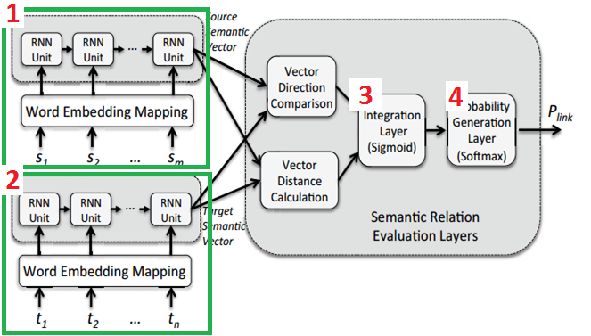
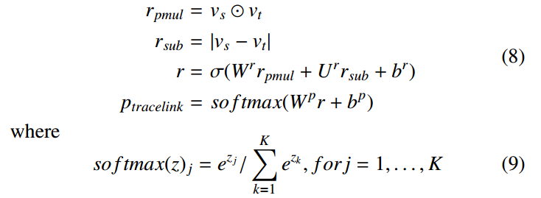
Architecture
1 | Word embedding vectors from source artifact (s1, s2…, k) are send it to RNN layers sequentially and output as a single vector representing its semantic meaning
2 | Word embedding vectors from target artifact(t1, t1…, k) are send it to RNN layers sequentially to and output as single vector representing its semantic meaning
3 | Sigmoid function output a single vector to represent semantic similarity
4 | Softmax function calculate the probability that valid trace links exist between these two artifacts (eg., 0,1)

Slide 8
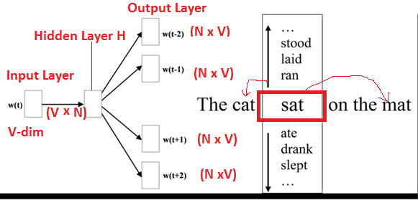

Skip-gram Word Embedding
Word Embedding – Features learning techniques in NLP. It can capture a context of a word in the document-based semantic and syntactic similarity, relations with other words. Mapping of words in Vector Space
Work2Vec – is the techniques to learn word-embedding
Skip-gram –predict the context words for a given target word.
w(t) | the weight matrix and the input vector Eg (One Hot Encoding Vector of cat = {0, 1, 0 , 0, 0})
N | No of neuron
V | Vector
Window Size 2 | (t-2,t-1, t+1, t+2 )
Softmax

Slide 9
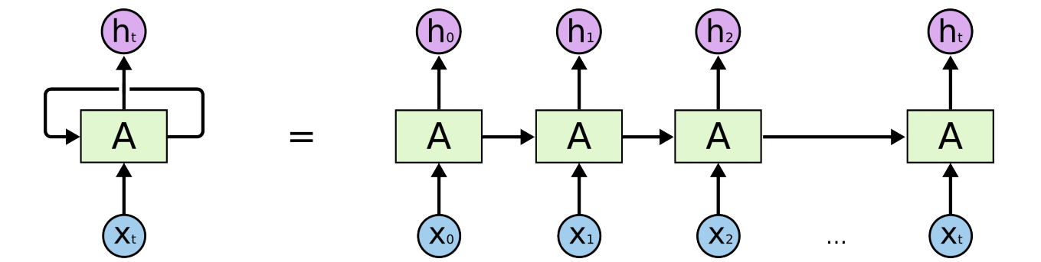




Recurrent Neural Network
Input Layer
Hidden Layer

Slide 10
References
https://towardsdatascience.com/introduction-to-word-embedding-and-word2vec-652d0c2060fa
http://projector.tensorflow.org/
https://www.youtube.com/watch?v=gXb1_2sIiYI
https://colab.research.google.com/drive/1oaXvyUjltFRHMyl6aMySxDs9BP9YiHvq

